Slide 1
2020 IM Facility Assessment Prepared for: Co-Sponsors Gore and Bollman January 2021

Slide 2
Guiding Principles for IM Facilities Assessment 2020
Student Success – Provide facilities that support programming to strengthen mind, body, and spirit. Seek student input for their needs and support of fee model.
Excellence – Provide modern facilities with state-of-the-art conditions and programmatic flexibility. Provide facilities commensurate with our peers.
Optimization – Maximize facility utilization, and operational efficiencies that reduce operational redundancies and life-cycle costs.
Diversity, Equity, and Inclusion – Facilities, programs, and participation must be equitable, accessible, and affordable for all Spartans.
Partners – Achieve collective goals working collaboratively with campus partners to serve all Spartans.
Community – Provide facilities that encourage community building, social engagement and promotes campus wellbeing.

Slide 3
Study Mission
Study Co-Sponsors: Vennie Gore, SVP Dan Bollman, VP
Goal of the assessment:
To provide enough direction on project scope and probable User Fees to request Board of Trustees Authorization in February to hire a consultant to conduct an IM Facility Feasibility Study in 2021.
Basis of Design:
2017 Moody Nolan Health and Wellness Study

Slide 4
Study Committee
Vennie Gore Dan Bollman
Rick McNeil Bob Patterson
Diane Barker Paul Manson
Bill Whitbeck Alan Haller
Barb Kranz Lesley Comer
Steve Troost Dick Temple
Note: Cost Models by IPF\Brian Mullen

Slide 5
Study Timeline
Study Kick-off Meeting …………………............. November 5, 2020
Draft Recommendation…………………………. December 21, 2020
Final Edits …………..……………………………. January 18, 2021
Board of Trustees Work Session……………….. February 11, 2021

Slide 6
Rationale to Conduct a 2021 IM Facility Feasibility Study
Define IM Facility Programs that meet NIRSA Standards compliance
Address Financial Constraints to the proposed User Fee models
define a plan that addresses NIRSA Standards compliance
Test –a phased implementation facility plan
Test – a plan to improve Facilities without meeting 100% NIRSA compliance
Evaluate the “value” of a New vs. Renovated IM West
Quality of program space
Operational continuity
Site evaluations
Prioritize projects for implementation
Engage students and other stakeholder groups
Integrate the IM Facilities into the Health & Well Being initiative
Evaluate if the Multicultural Center is funded by the User Fee
Integrate IM Facility Plan with Intercollegiate Athletics’ Master Plan to identify opportunities and synergies
Test project schedule viability with:
IM Facilities initiatives
Intercollegiate Athletics’ facility initiatives
Multicultural Center initiative
Integration with the 2021 Campus Master Plan Study

Slide 7
Point of Reference
The National Intramural and Recreation Sports Association (NIRSA) are the standards that MSU should strive to meet.
IM Facilities are an important component of the MSU Health, Well-Being and Recreation community mission.
Existing IM facilities have served the MSU community well, but do not meet NIRSA standards. The facilities have functional and infrastructure deficiencies.
IM Circle Built 1916 with 1950’s addition 100-years old
IM West Built 1959 60-years old
IM East Built 1982 40-years old
The 2017 Moody Nolan Health & Wellness Study is the Basis of Design for this study.
User Fees are a potential funding source for the IM Facilities and should be evaluated relative to the user fees at the BIG10 cohort universities.
The Multicultural Center mission aligns with the IM facility initiative.
The Committee’s charge is to provide information for MSU to make a decision.

Slide 8
National Intramural-Recreational Association (NIRSA)
“National Intramural-Recreational Association (NIRSA), is recognized by Colleges and Universities across the United States as leaders in collegiate recreation. They author standards that form the benchmark for the quality and quantity of spaces related to recreation, sport and wellness.”

Slide 9
Health, Well-Being and Recreation
Concept
A collaboration of campus partners working cross-functionally across multiple departments to create a healthier community for students, faculty and staff. These partners can be organizationally separated, (as is the practice now), or consideration for a new organization of Health, Well-Being and Recreation with the potential for these units to be represented in a new build facility.
Well-Being (Broadly defined by NIRSA)
An optimal and dynamic state where people have a sense of purpose and an opportunity to achieve their full potential.
Where people feel positive and believe their lives are rewarding – i.e., they rank themselves high on measures of happiness and life purpose
When basic human rights and needs are met – i.e., food and housing securities, safety, mental/physical health, equity and diversity, liberty, freedom, justice and others.
Where members are contributing to the communities in which they live – i.e., Institution, local state, global, recognize their own value and impact on their communities, over come social injustice, among others.

Slide 10
Assessment Grading Criteria – Existing Conditions
Assessment Grading Criteria – Existing Conditions

Slide 11
Assessment Grading Criteria - IM West
Basement
1st Floor
Note: Graphics do not include work implemented after 2017
* Information Presented in 2017 Moody Nolan Report
2nd Floor

Slide 12
Post 2017 IM Facility Study General Fund Work Implemented
IM West Outside Pool Demo\Infill………………………... $820,000
IM West Indoor Pool HVAC Replacement…………….. $3,960,000
West Turf Room………………………………………….. $3,220,000
Dem Hall Multi-Sport Court……………………………... $1,750,000
IM East Elevated Track………………………………….. $1,700,000
Service Road Fields………………………………. Not Implemented
TOTAL……………………………………………………. $11,450,000

Slide 13
Post 2017 IM Facility Study General Fund Work – Example:
Dem Hall Multi-sport Court

Slide 14
Post 2017 IM Facility Study General Fund Work – Example:
IM West Turf Room
IM East Elevated Track

Slide 15
2021 Preliminary Capital Renewal IM Facility Needs
NOTE: Information provided by ISES Corp - 2020 MSU Facility Condition Assessment

Slide 16
Assessment of New Build vs. Renovation
West Renovation Pros:
Phased renovations over time minimizes up-front investment costs and debt/credit rating limitations
Maintains a central campus location with optimal accessibility for students, faculty, and staff
Munn Fields can remain operational
IM West Renovation Cons:
Building replacement cost out of balance with required Capital Renewal
Water intrusion of lower floors remains (racquet ball courts)
Disruption to users during renovations
LEED building standards can not be achieved (natural daylight, air quality, etc.)
Limited area for aquatic venue expansion
Restricted site area for future footprint expansion
Original building program/design not conducive for modern IM facility
Inefficient use of floorplan (excessive net to gross inefficiencies)
Older mechanical and electrical systems will not provide performance efficiencies like a new build (life cycle costs)
Inability to provide overall program requirements for optimal wellbeing needs
Limited ability to provide a high-quality facility/image for recruitment and retention goals
Will require extensive ADA and other code compliance requirements throughout building
Difficult to transform the facility in support of the health, wellbeing and recreation concept

Slide 17
Assessment of New Build vs. Renovation
New Build Pros:
Ability to meet known student, faculty, and staff needs
Ability to meet NIRSA standards (fields excluded)
Creation of a high-quality facility to help recruit and retain students, faculty, and staff
Ability for MSU to earn recognition as a Health Promoting University with wellbeing an intentional design focus:
Transform the health and sustainability of students, faculty and staff.
Build to accommodate services of health promotion, nutrition, substance abuse, sexual health, mental health, employee assistance and others.
Build space to serve multi-functional users listed above
Locating representatives of health service units together creates synergies that go beyond collaborations, ability to work side-by-side
Build to remove the stigma of seeking help
Provide a symbol of university commitment to an excellent student experience
Provide facilities for building community and connections
Allows existing facility operation during construction
Modern mechanical and electrical systems more efficient with lower annual operating costs (life cycle)
Ample site area for future expansion
Ability to achieve LEED building standards (natural daylight, air quality, etc.)
Adequate facility space to consider community memberships/partnerships
New Build Cons:
Impact to university debt limit and credit rating if not phased. Phasing will add time and money.
Possible location further than optimal for student, faculty, and staff access
Site options other than current location will compromise accessibility by visitor parking restrictions during events at Breslin

Slide 18
Big 10 Comparison of Facility Fees
MICHIGAN STATE UNIVERSITY DIVISION OF STUDENT AFFAIRS AND SERVICES STUDENT RECREATION CENTER FEE COMPARISON |  |  | DRAFT | 11/4/2020
FY2020-21 | MANDATORY STUDENT | MANDATORY STUDENT | OPTIONAL STUDENT | OPTIONALFACULTY/STAFF
 | RECREATION FEE? | RECREATION FEE | RECREATION FEE | RECREATION FEE
SCHOOL | YES / NO | Fall - Spring Semester | Fall - Spring Semester | PER CALENDER YEAR
ILLINOIS | YES | $369 | $0 | $480
INDIANA | YES | $213 | $0 | $570
IOWA | YES | $300 | $0 | $468
MARYLAND | YES | $400 | $0 | $456
MICHIGAN | YES | $130 | $0 | $380
MICHIGAN STATE | NO | $0 | $297 (fitness unlimited) | $445 (fitness unlimited)
MINNESOTA | YES | $237 | $0 | $480
NEBRASKA | YES | $389 | $52 mandatory if summer enroll | $492
NORTHWESTERN | YES | $213 | $0 | $400
OHIO STATE | YES | $246 | $0 | $491
PENN STATE | YES | $114 | $0 | $230
PURDUE | YES | $234 | $0 | $375
RUTGERS | YES | $1347*** | $0 | $375
WISCONSIN | YES | $316 | $79 mandatory if summer enroll | $40 per month for All-Access, $21 per month for Classic
 | MANDATORY STUDENT | MANDATORY STUDENT | OPTIONAL STUDENT | OPTIONAL FACULTY/STAFF
 | RECREATION FEE? | RECREATION FEE | RECREATION FEE | RECREATION FEE
SCHOOL | YES / NO | PER YEAR | PER YEAR | PER YEAR
CENTRAL MICHIGAN | YES | $120 |  | $288
WESTERN MICHIGAN | YES | na |  | $270
GRAND VALLEY | YES | na |  | N/A
OAKLAND UNIVERSITY | YES | $150
EASTERN MICHIGAN | YES | $100

Slide 19
Option Cost Model

Slide 20
Next Steps
Hire Architect and Engineering Firm to conduct detail feasibility study
Explore funding models
Provide BOT with a final report

Slide 21
Appendix
Additional Data

Slide 22
User Fee Project List (to achieve NIRSA Standard Compliance)
IM West Facility
Renovate or Replace?
If new, where?
IM East Facility
IM West Fields
IM East Fields
Multicultural Center
Not in Scope of Work:
Jenison
Dem Hall
Arena
IM Circle

Slide 23
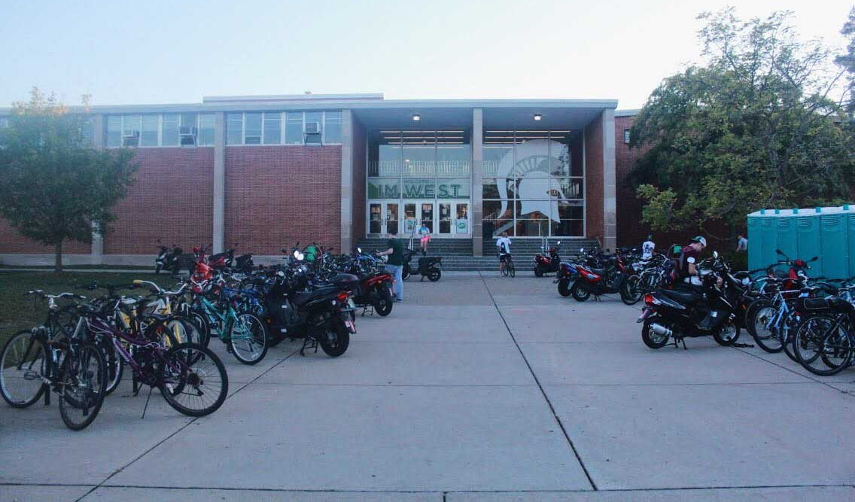
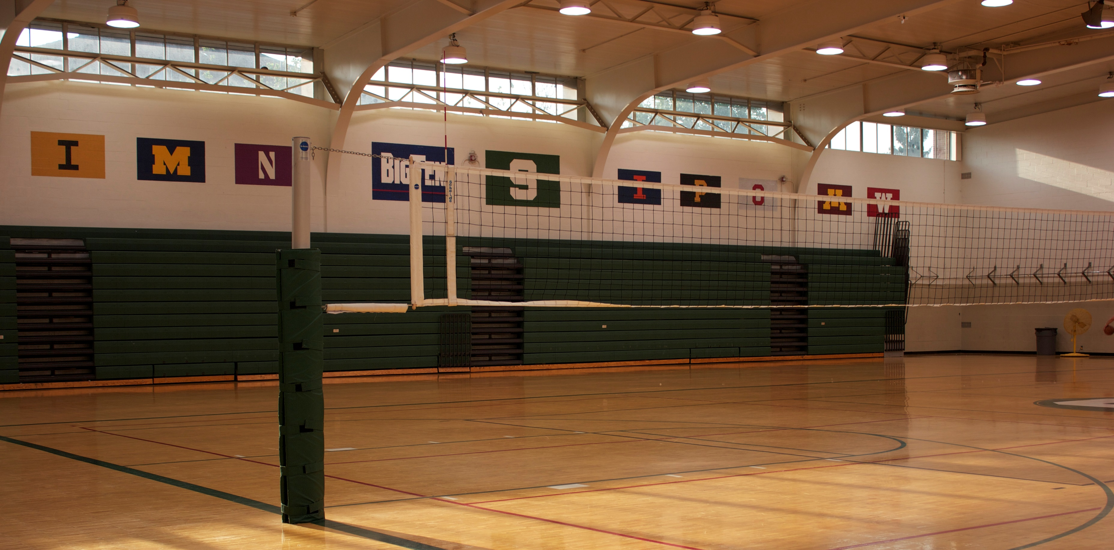
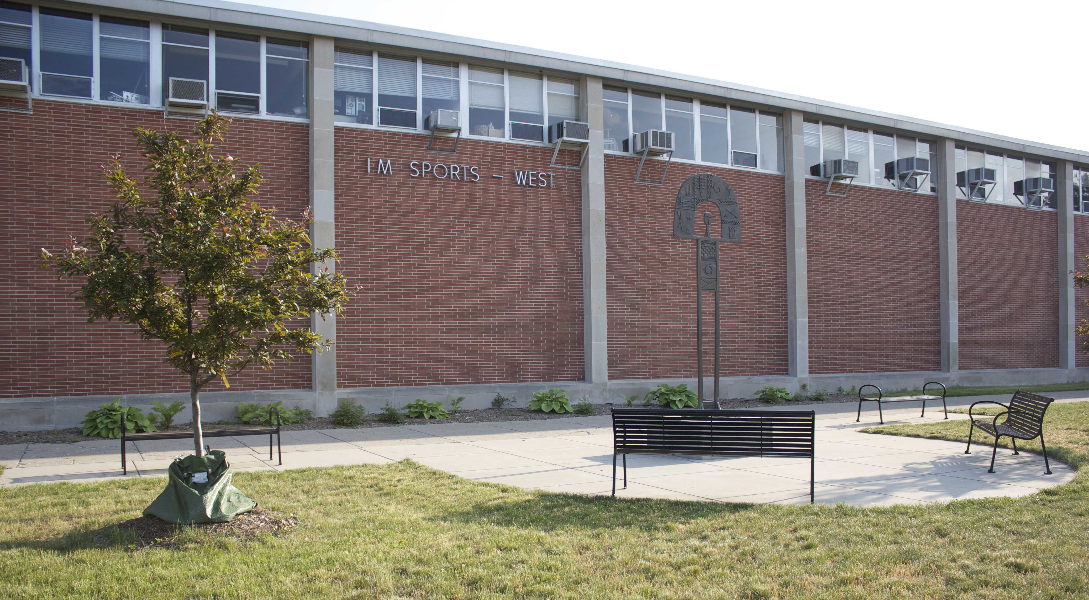
IM West Fitness Center
Built in 1959

Slide 24
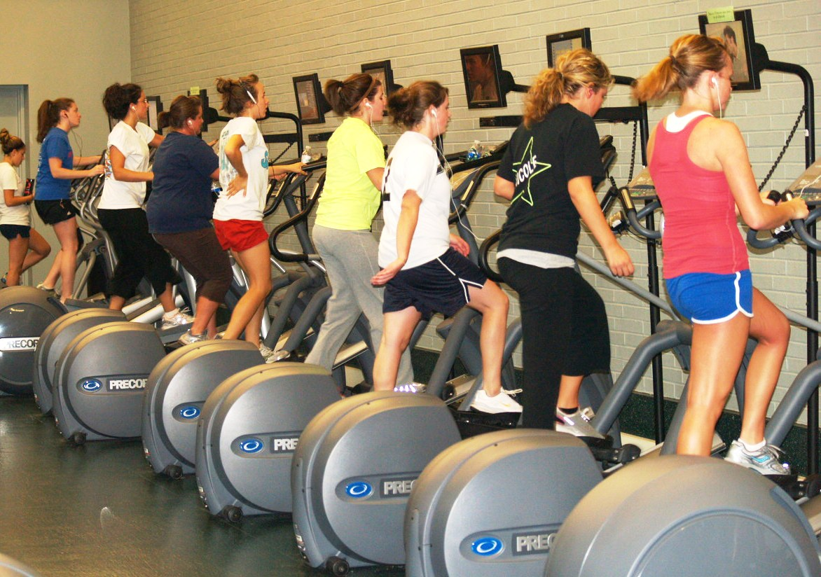
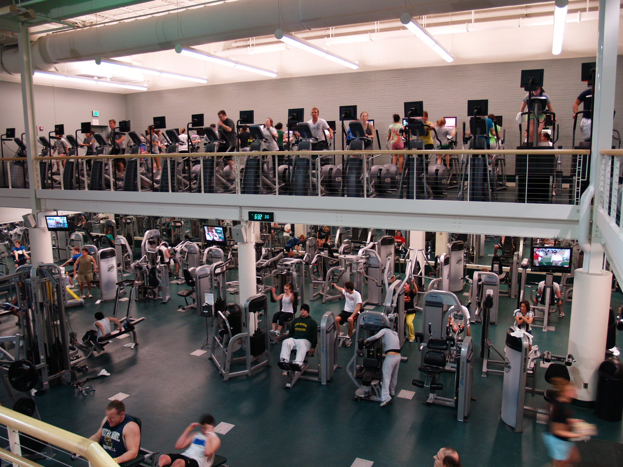
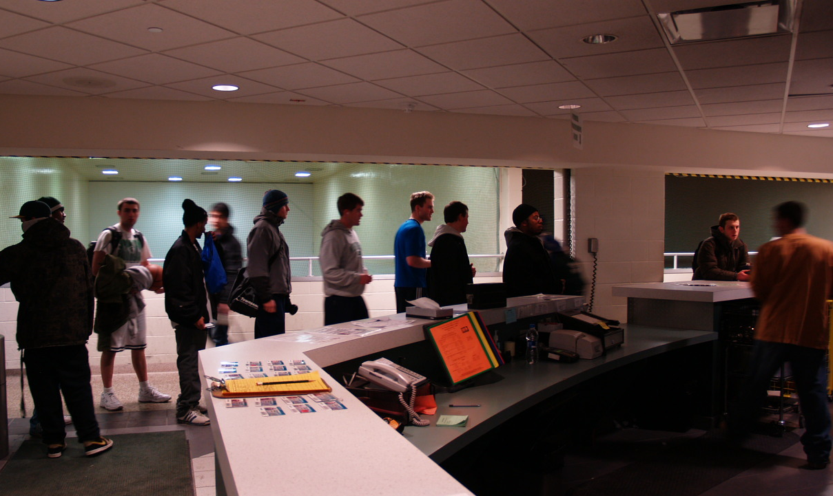
IM West Fitness Center
Common overcrowding

Slide 25
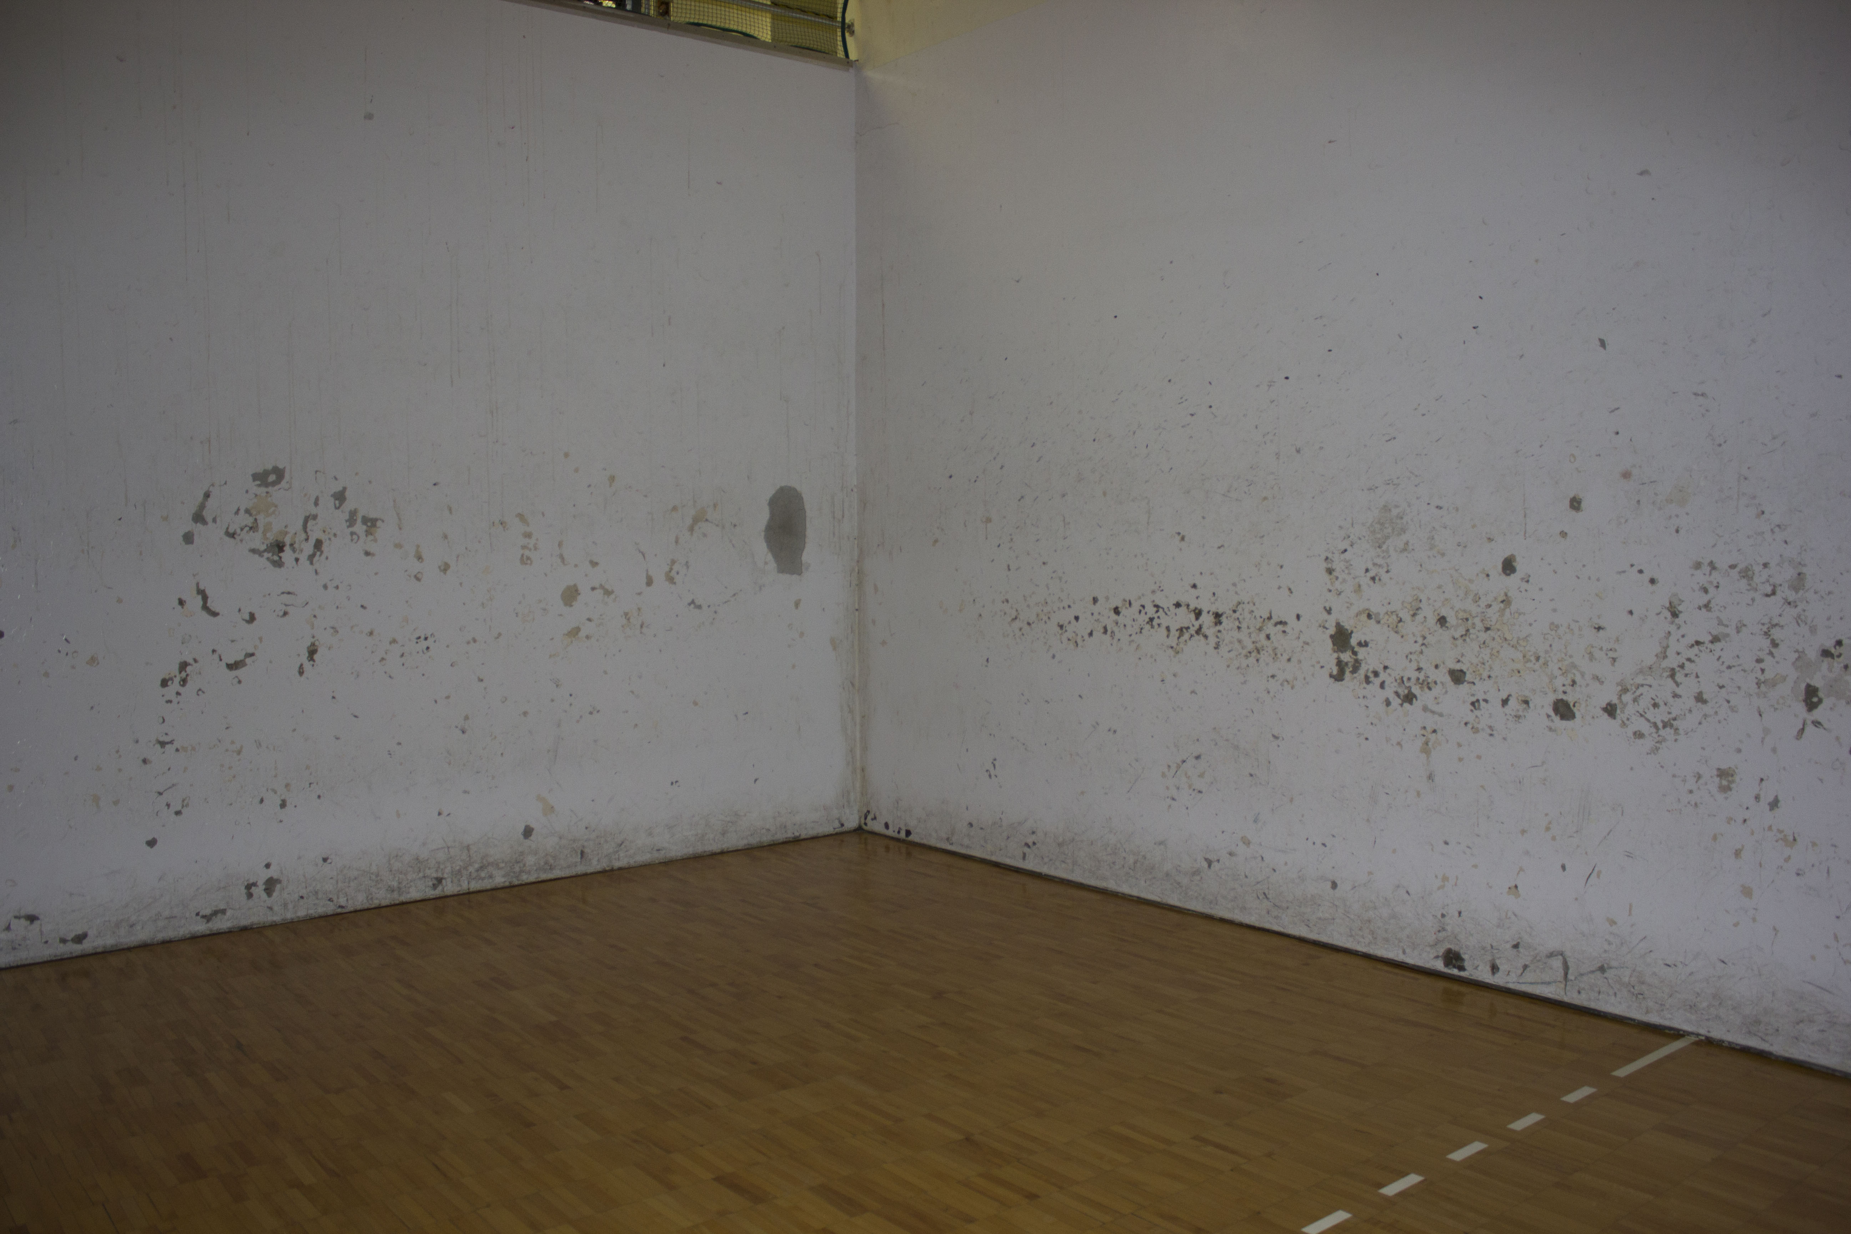
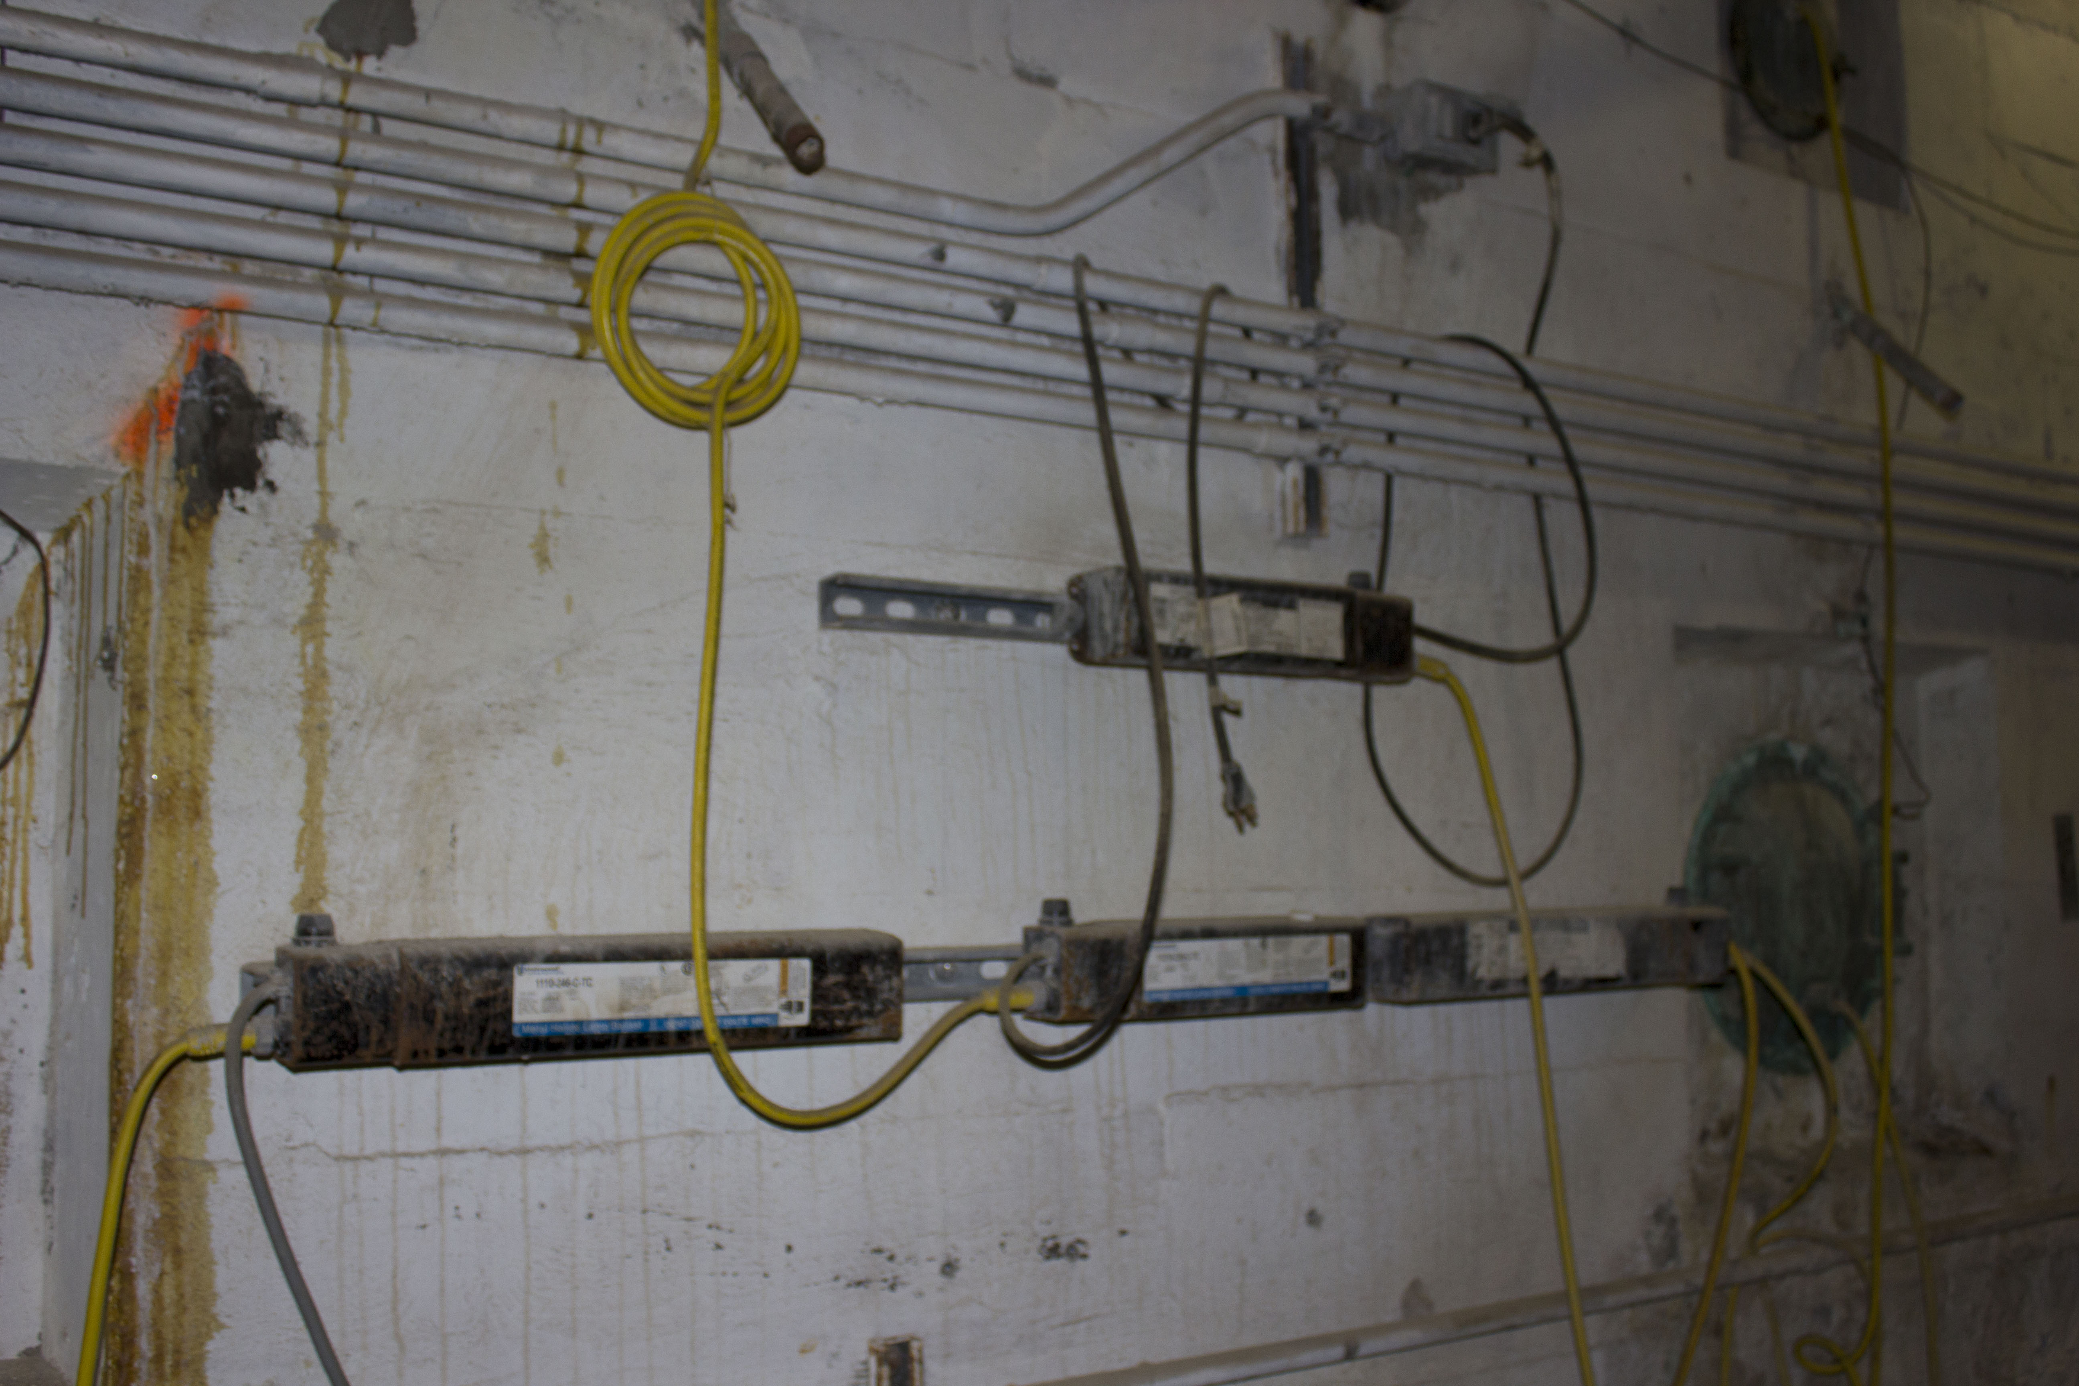
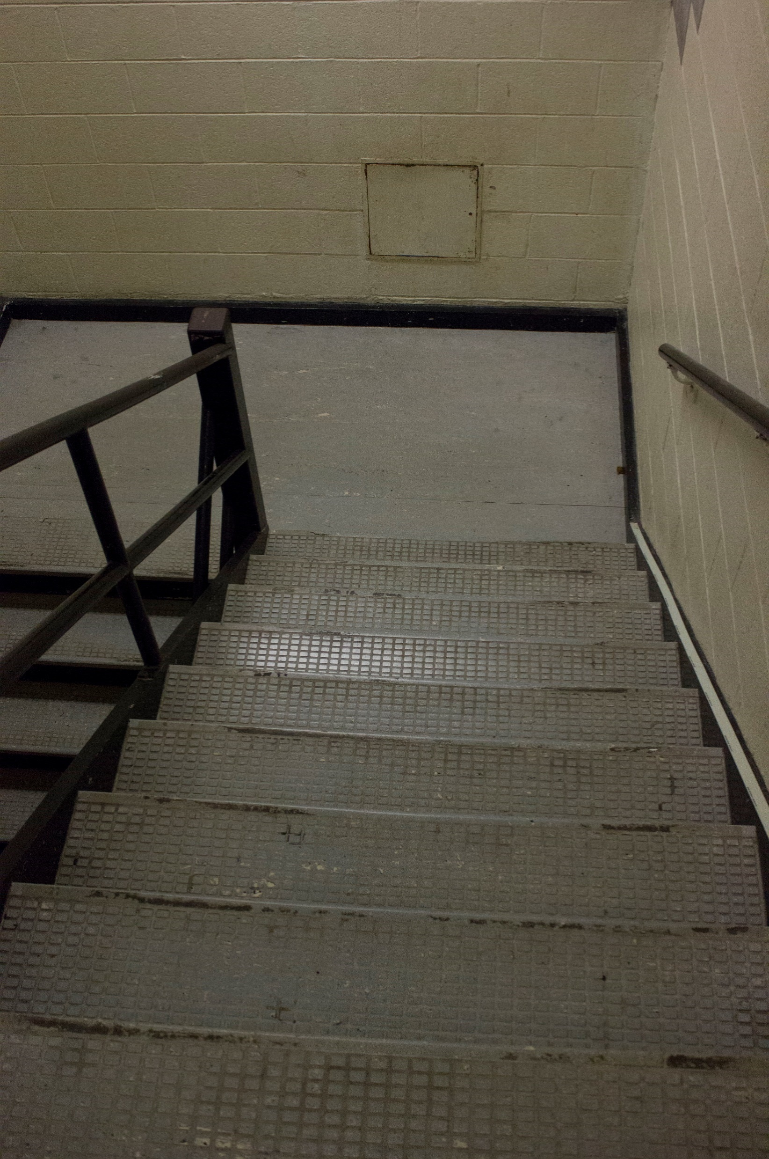
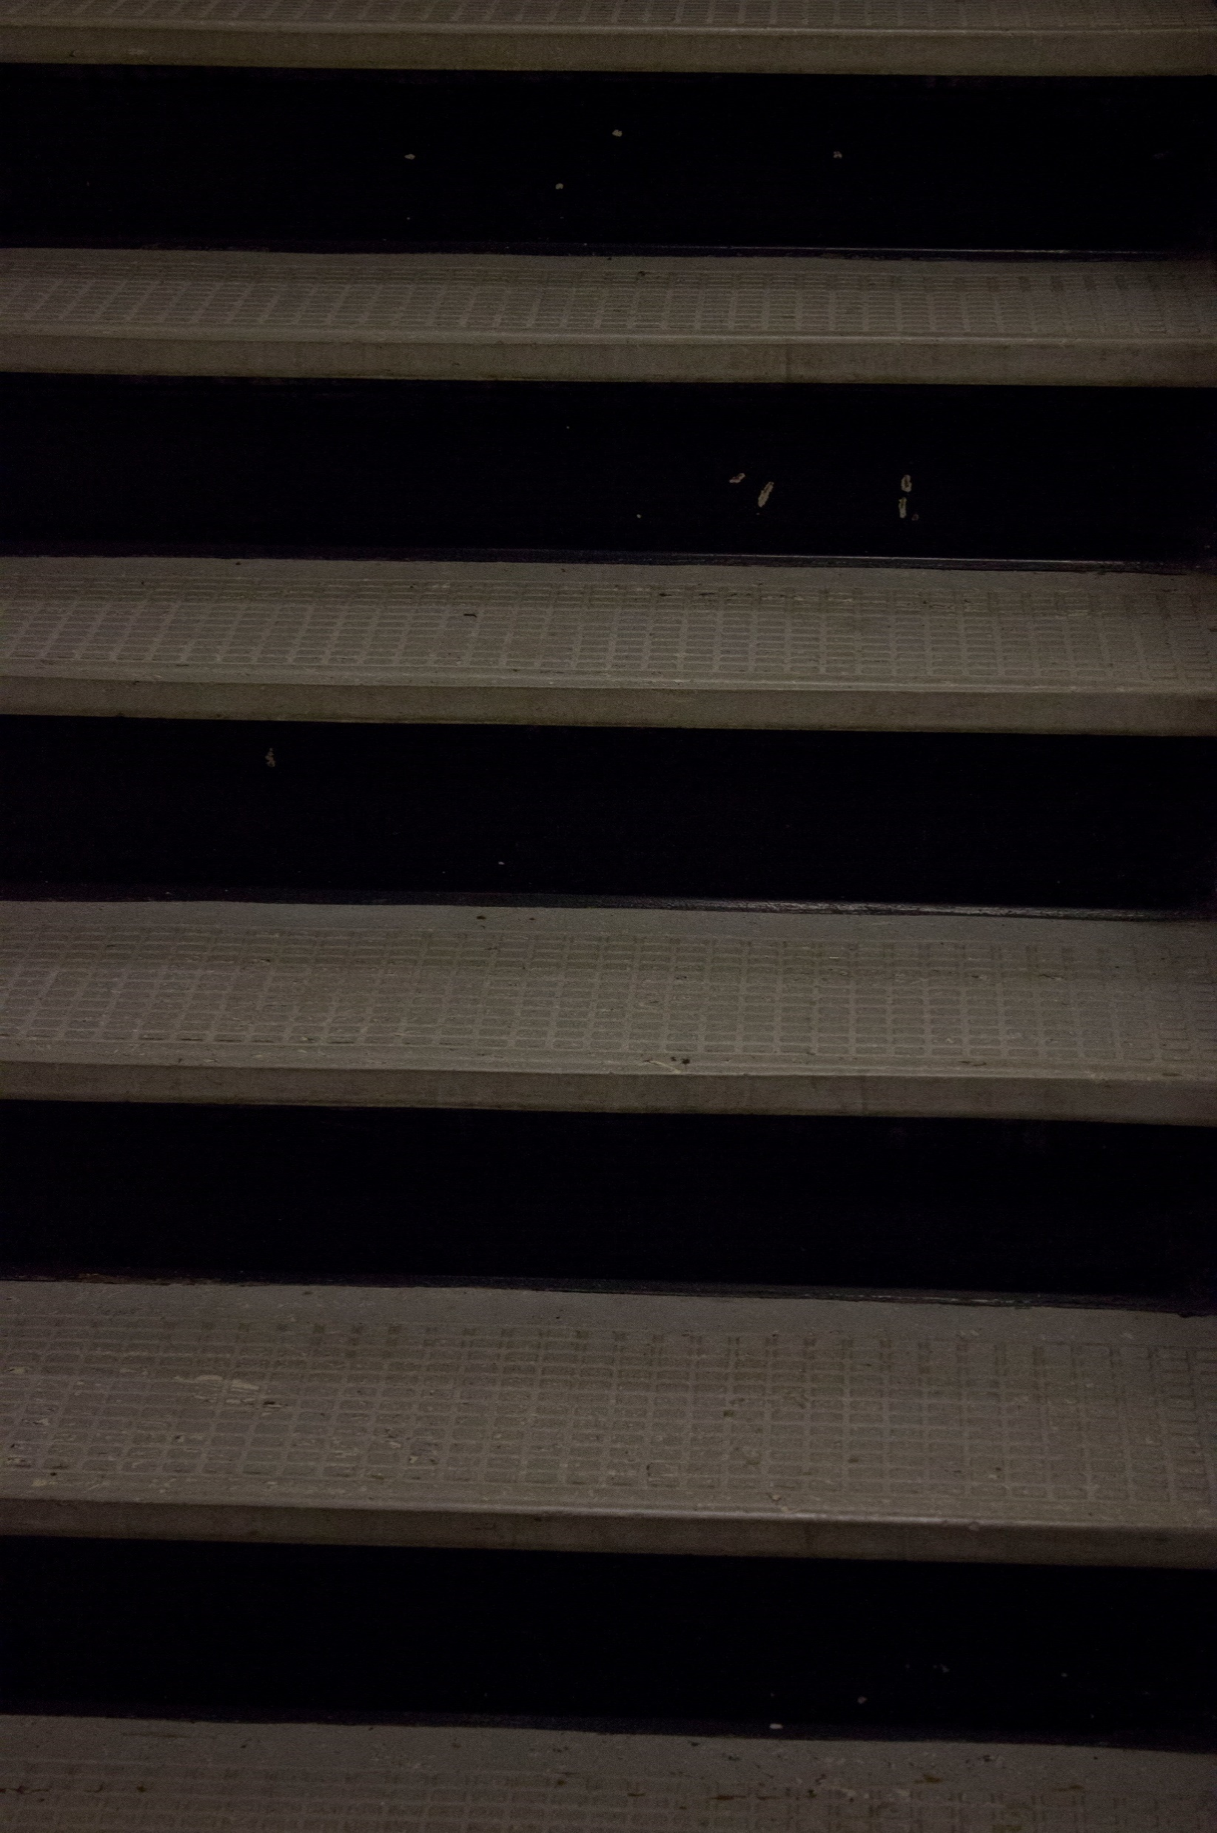
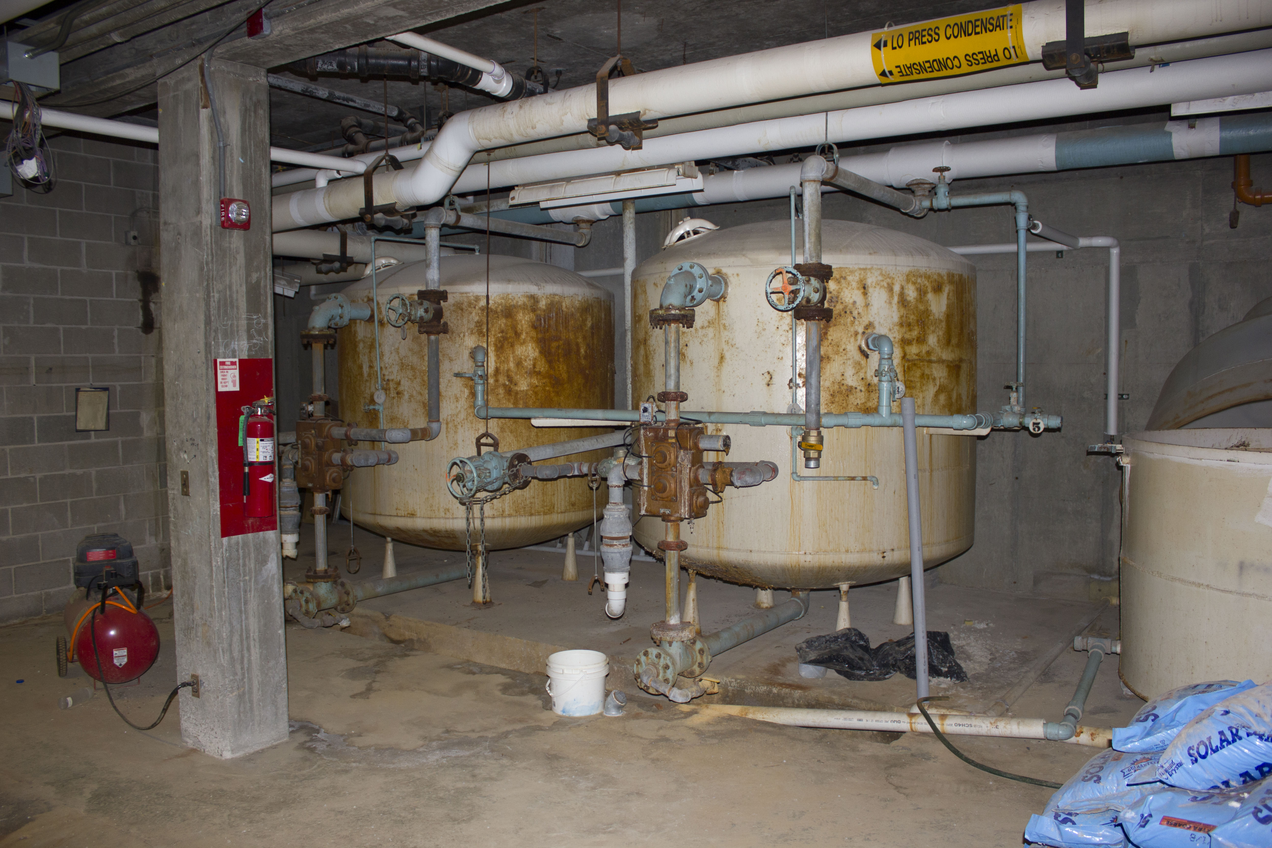
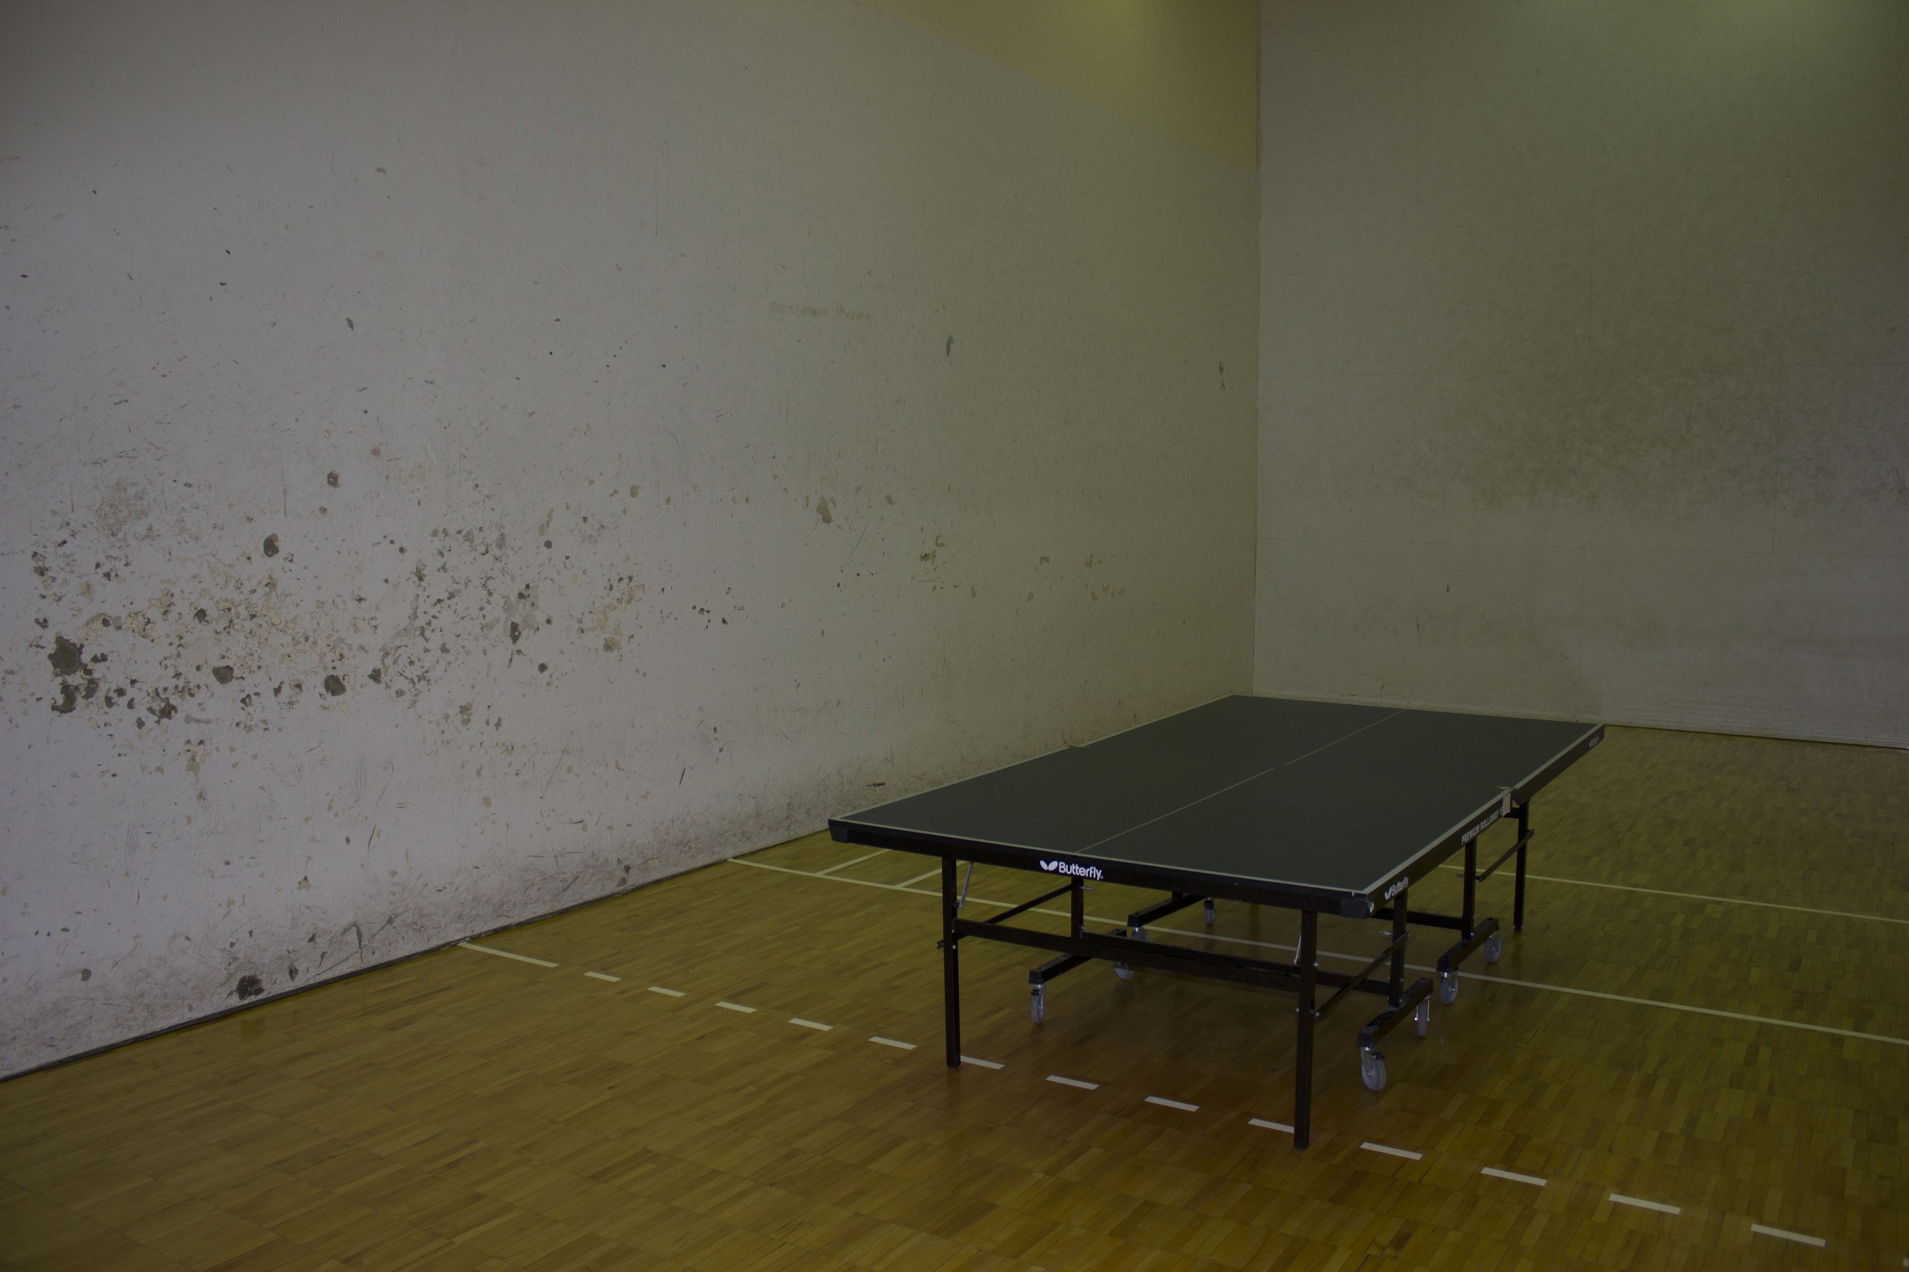
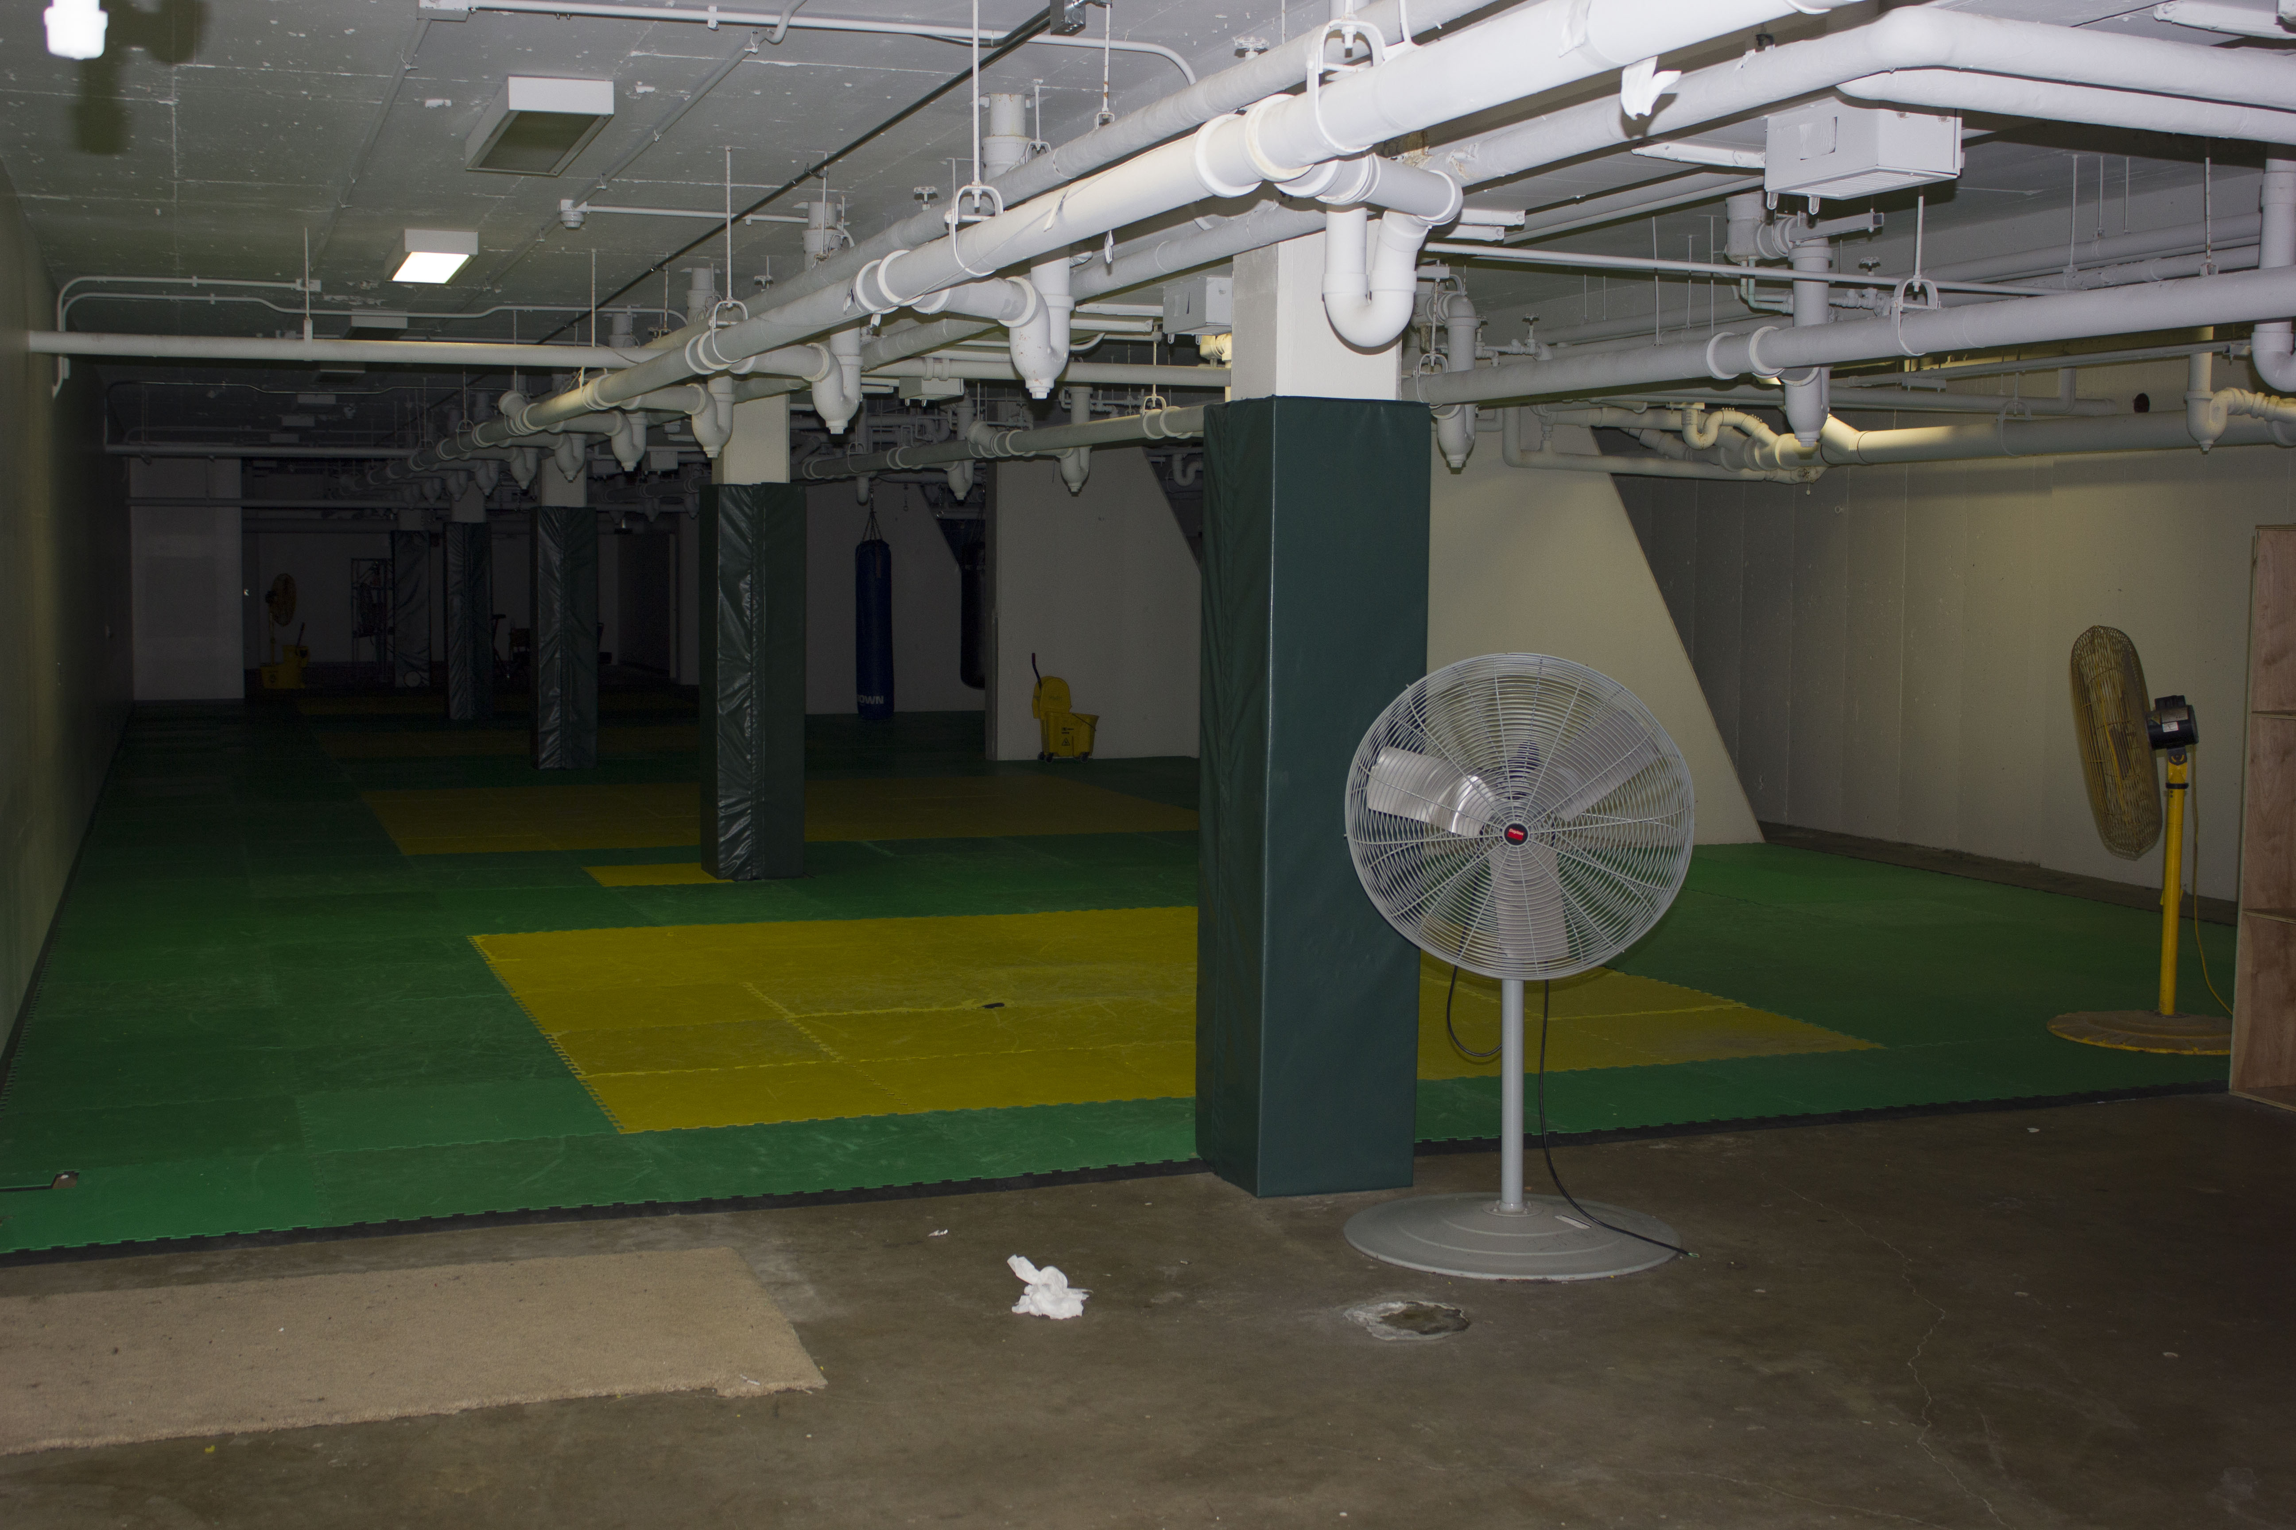
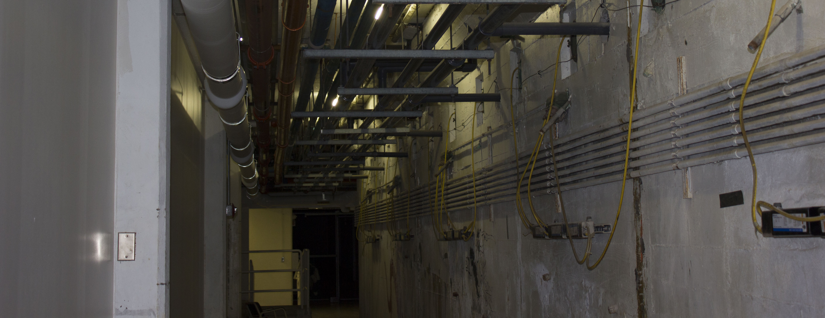
IM West Conditions Worsen
Racquetball court
SPARTANS PLAY HERE
Martial Arts Studio

Slide 26
User Fee Models
2017 Moody Nolan Study
$252 User Fee Generates $217m
$259 User Fee Generates $223M
$260 User Fee = BIG10 Ave.
$281 User Fee Generates $242M
$340 User Fee Generates $293M
2017 Moody Nolan Study identified $333m in projects
Note: All other BIG10 Universities have a User Fee

Slide 27
NIRSA Recommendations Benchmarking – 2017 Indoor
* Information Presented in 2017 Moody Nolan Report

Slide 28
NIRSA Recommendations Benchmarking – 2017 Outdoor
* Information Presented in 2017 Moody Nolan Report

Slide 29
Updated NIRSA Compliance Matrix – Existing Conditions PRELIMINARY (Dec. 3)
Deficit of 133,000SF
Swimming significant deficit
Fitness significant deficit
Fields significant deficit
Existing IM West program space is rated as “C & D” by Moody Nolan 2017 study. Even if remodeled it will have some functional deficiency.
Existing IM West Facility Infrastructure beyond Useful Life

Slide 30
Updated NIRSA Compliance Matrix – New Building
Replacement Building 330,000SF (based on 2020 conceptual space program by Moody Nolan)
New 50-meter Pool (no diving)
Specialty Programs
New Turf Fields

